Slide 1
2015 Conaway Conference
Proposal Note 555 Surface Smoothness for Bridges and Approaches
Jim Welter, P. E.
Construction Structures Engineer ,
Office of Construction Administration
Brian Schleppi,
Infrastructure Management Administrator,
Office of Technical Services

Slide 2
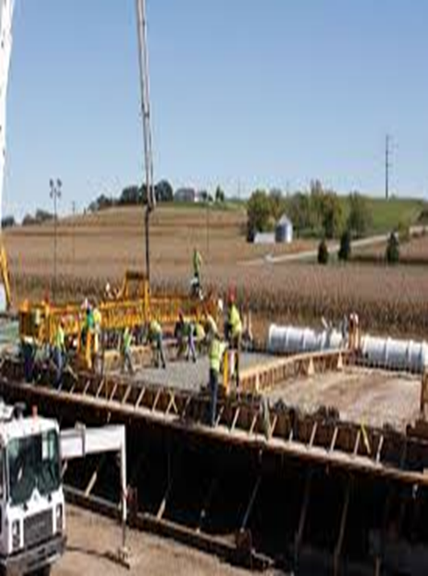
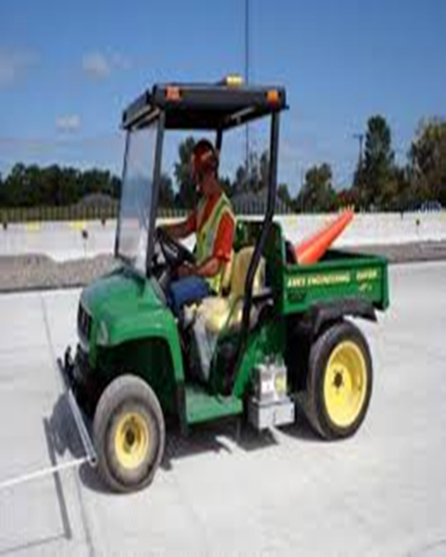
Proposal Note 555 Surface Smoothness for Bridges & Approaches

Slide 3
Proposal Note 555 Surface Smoothness for Bridges & Approaches
Latest versions of applicable Proposal Notes and Supplements
PN 420- Surface Smoothness Requirements for Pavements 7/18/2014
PN 470 – Thin Lift Asphalt Surface Smoothness Requirement 7/18/2014
PN 555 – Surface Smoothness for Bridges and Approaches 4/18/2014 (Revision in Section 4. Mandatory Corrective Work “Anytime PN 420 is used in conjunction with PN 555, the localized roughness criteria for the pavement within one foot of the approach slab will be governed by the criteria in PN 420 [IRI in any 25 foot (7.6 m) segment not to exceed 160 inches per mile (3.94 m/km).”) (Will be updated 4/17/2015)
Supplement 1058 – Surface Smoothness Equipment and Operator Requirements 4/18/2014
Supplement 1110 – Submittal and Application Requirements for ProVAL Pavement Smoothness Software 4/18/2014
Supplement 1112 - Submittal and Application Requirements for ProVAL Highway Smoothness Software for Bridge Encounters 1/20/2012 (Will be updated 17/2015)

Slide 4
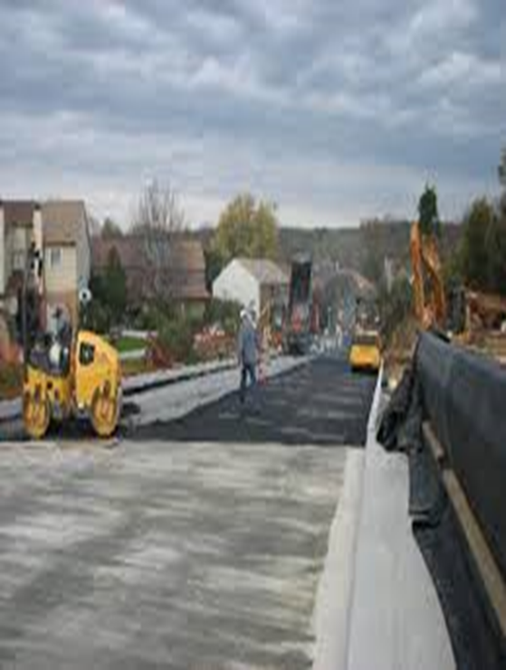
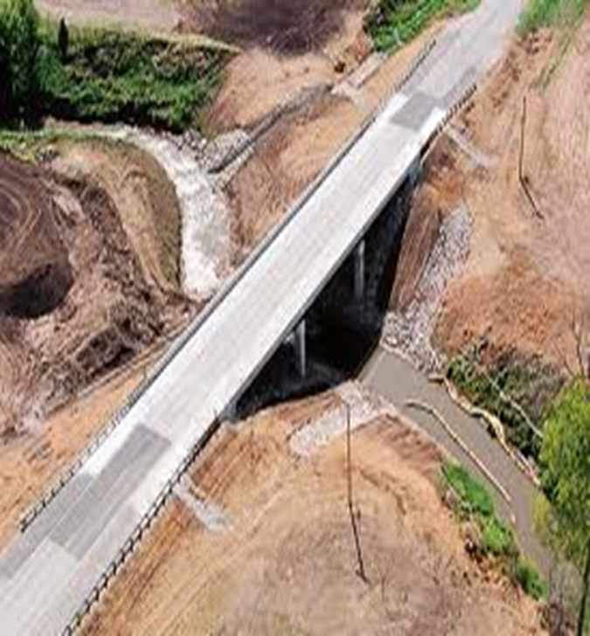
Proposal Note 555 Surface Smoothness for Bridges & Approaches

Slide 5
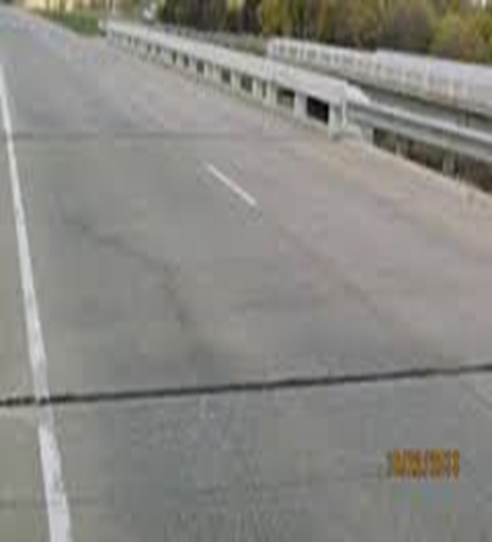
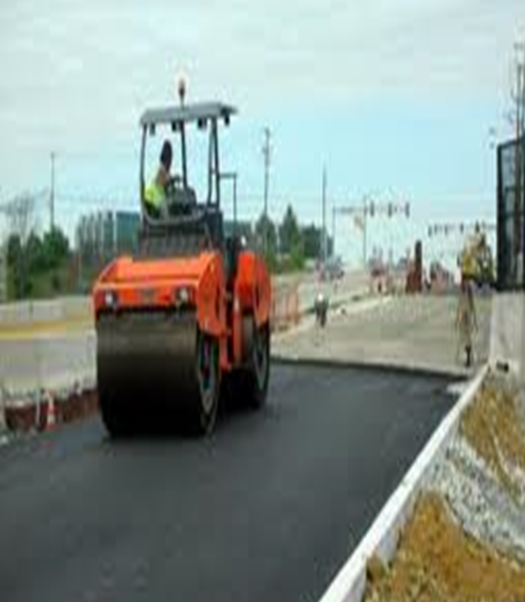
Proposal Note 555 Surface Smoothness for Bridges & Approaches
Notes:
Important that the Crews/Contractors that are placing the bridge deck concrete, approach slab concrete, and approach pavement,(concrete or asphalt) are on the same page
(Proactive, not Reactive)

Slide 6
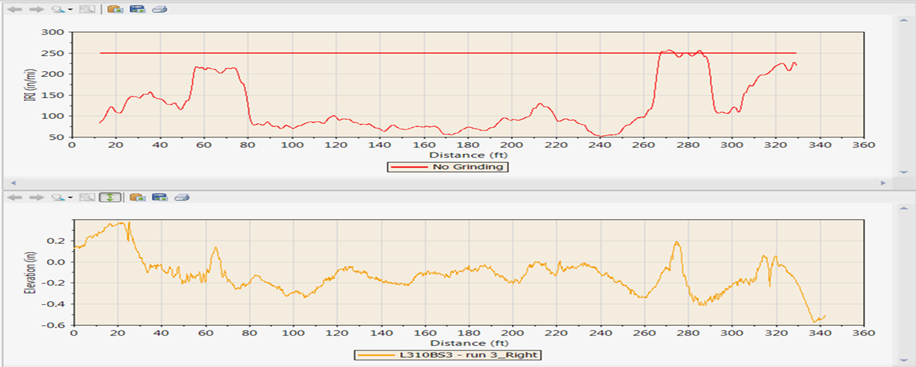
Proposal Note 555 Surface Smoothness for Bridges & Approaches Once the surface smoothness measurements are collected, the results are to be analyzed by the ProVAL software
Notes:
Top graph is 25’ base length continuous report while bottom graph is the actual inertial profile. The profile caused the roughness to increase.

Slide 7
Proposal Note 555 Surface Smoothness for Bridges & Approaches
ProVAL is used to determine compliance with the tolerances in PN 555
Each lane of encounter must be built to an IRI of 130 inches/mile or less
If not, then must be corrected to an IRI of 100 inches/mile or less
Notes:
International Roughness Index (IRI) is a composite model of vehicle suspensions
IRI is sensitive to roughness wavelengths from about 1 to 2 feet (tire patch) to 300 feet. Beyond 300 feet, the entire vehicle moves with the general grade without suspension movement.
IRI model simulates each wheel track across the collected inertial road profile with a simulated travel speed of 50 mph
IRI provides a mathematical assessment of the section profile aimed at quantifying the quality of the ride in a passenger car.
MRI (Mean IRI) average IRI of both wheel paths in the given lane
Overall criteria waived if bridge encounter is less than 265 feet in length
Overall roughness criteria has to be waived for shorter bridges as one bump or dip or roughness event counts more and more as the bridge encounter gets shorter.

Slide 8
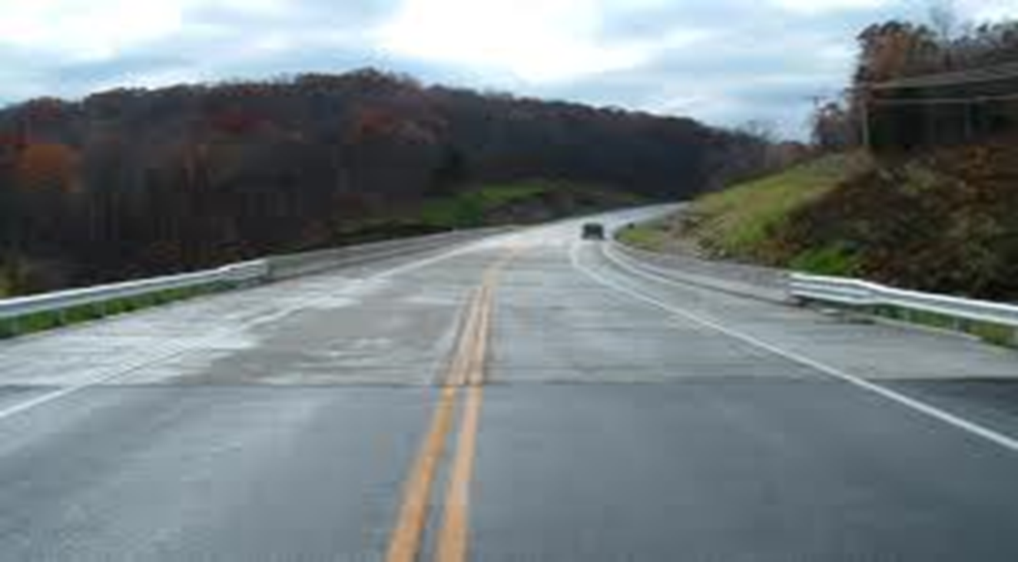
Proposal Note 555 Surface Smoothness for Bridges & Approaches

Slide 9
Proposal Note 555 Surface Smoothness for Bridges & Approaches
Each wheel path must not exceed an IRI of 250 inches/mile on a continuous 25 foot base length
If not, then must be corrected to an IRI below 250 inches/mile in 25 feet
Limit is increased to 350 inches/mile anywhere the sliding 25 foot base length includes steel armor
Notes:
The 25 foot sliding baselength in effect becomes a roughness “hotspot” locator. The shorter the baselength the more each individual roughness event counts to get back to units of vertical inches of roughness per longitudinal mile. For 25 ft baselength, each roughness event that causes suspension movement gets multiplied a bit over 211 times. For 528 ft, each event only gets multiplied 10 times to get back to inches per mile units.

Slide 10
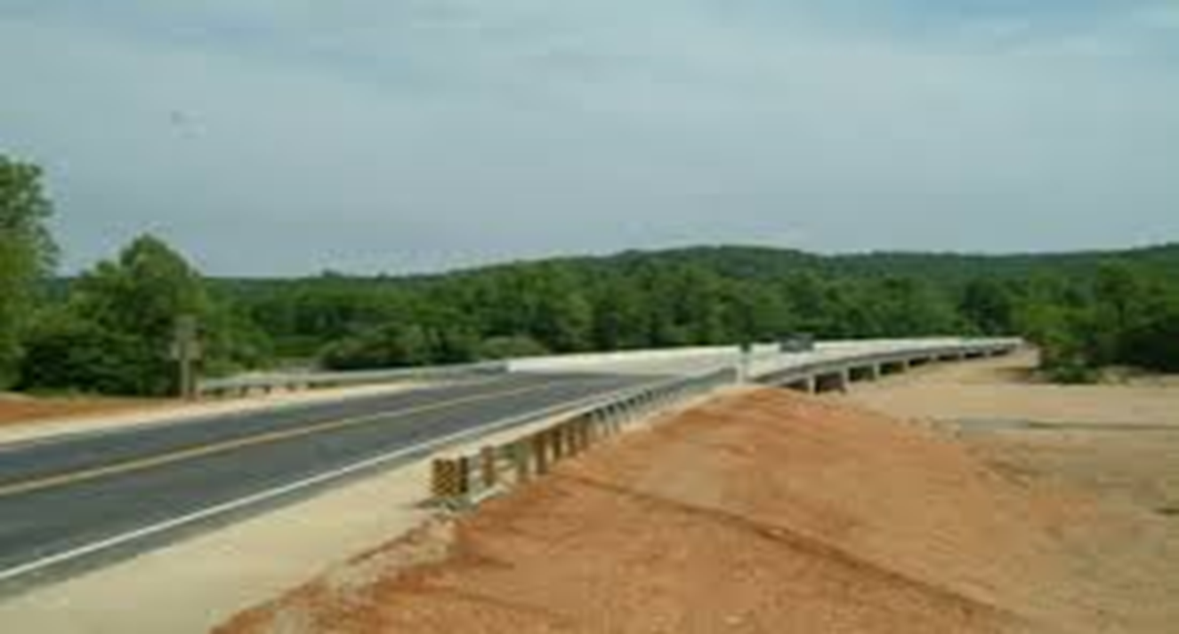
Proposal Note 555 Surface Smoothness for Bridges & Approaches

Slide 11
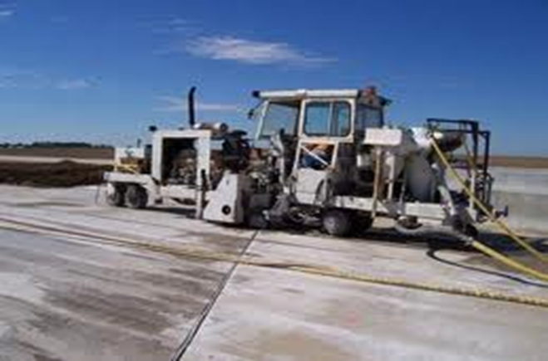
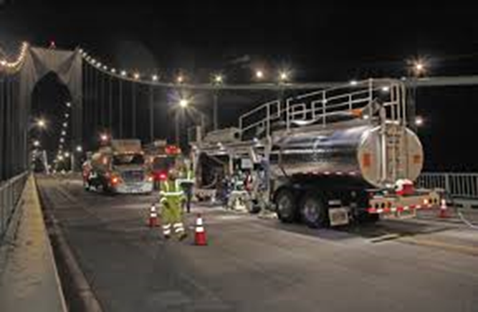
Proposal Note 555 Surface Smoothness for Bridges & Approaches Depending on the grinding machine model, the Smoothness Assurance Model in ProVAL is used to develop the Corrective Action Plan
Notes:
Some issues on bridges will require a specific grinder.
Some issues may require a long machine, 25 ‘ grinder and some short dips may require a short machine

Slide 12
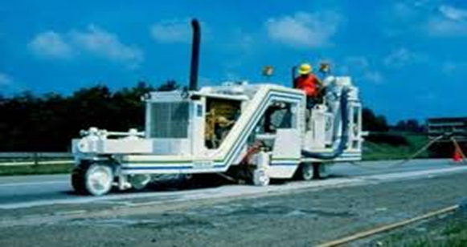
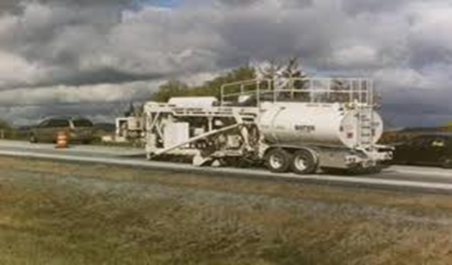
Proposal Note 555 Surface Smoothness for Bridges & Approaches If corrective action is required, a Corrective Action Plan must be submitted to and approved by the ODOT Project Engineer Re-testing after any corrective action is completed
Notes:
Submit plan 7 days before beginning corrective work.
Submit one copy of the following information to the Engineer: (1) corrective work plan;
(2) all IRI and MRI analyses; and
(3) all collected road profiles in ProVAL compatible format and one copy of the information will be sent to the Office of Technical Services; Attn.: Infrastructure Management Section, 1980 W. Broad St., Columbus, OH 43223.

Slide 13
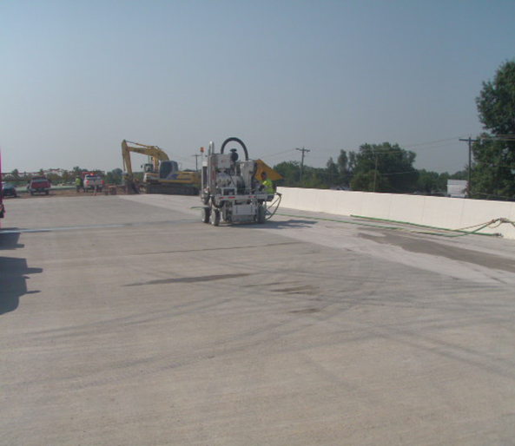
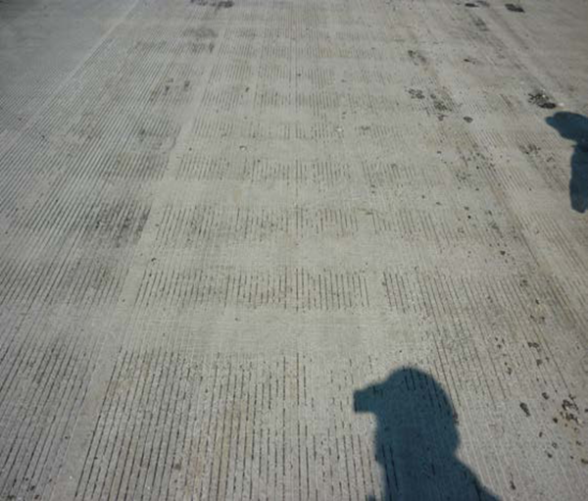
Proposal Note 555 Surface Smoothness for Bridges & Approaches If possible, correct smoothness prior to establishing longitudinal grooves
Notes:
PN 555 4.0 Mandatory Corrective Work. Feather areas adjacent to ground areas to provide a smooth surface. Re-groove diamond ground surfaces according to 511.17, if the existing grooves are less than 0.08 inches (2 mm) deep, at no additional cost to the Department. Replace pavement markings and raised pavement markers per the application 600 Item after grinding.
511.17 Bridge Deck Grooving. For staged, or phase bridge deck work, saw the grooves parallel to the final, permanent bridge centerline. If the different stages or phases of the bridge deck work occur within one construction season, any stage opened to traffic shall receive an interim coarse broom finish during placement, then saw the longitudinal grooves after the final stage. The interim broom finish will not be allowed as a surface texture when opened to traffic over a winter season. Saw longitudinal grooves in the deck prior to opening to traffic for a winter season.

Slide 14
Proposal Note 555 Surface Smoothness for Bridges & Approaches
Responses concerning PN 555 from Districts
Percentage of bridge decks with this note that have required grinding-
Almost all of the bridge decks with PN 555 have required grinding
Notes:
“most contractors did not realize the note requirements were on the project until later in the game.”

Slide 15
Proposal Note 555 Surface Smoothness for Bridges & Approaches
Responses concerning PN 555 from Districts
How well have the grinding plans been followed?
Most Contractors have followed the grinding plans
Notes:
“The contractor did turn in a grind plan, but it was found to be erroneous as the deck would still not be in compliance after the plan was followed. In order to keep the project schedule, the contractor agreed to do a blanket grind on the entire deck, including the asphalt / approach interfaces. This saved the time of a second grind plan and associated review time.“
“Plans were submitted and reviewed and discussed. Discussion was done several times actually but turned out ok. This being a fairly new note required some explanation and partnering to see it through.
The plans were used and followed and all of the decks actually had grinding but turned out riding very nicely.”
“There will need to be improvements to the corrective action plans, as I believe in a handful of cases, they are grinding too much. They will get better. “
“---- followed the grinding plan very well and by following the grinding plan were left with only a few minor violations after the plan was executed. “
“ No complaints from either party”
“___ seemed to do an excellent job following the Corrective Action Plan as it was submitted. The two bridges had different issues in their ride quality, but after the grinding, both improved significantly. The only area where a ‘bump’ didn’t seem permanently removed were the pressure relief joints, but even those were improved. We found great results where asphalt, old or new meets the newly placed concrete pavement/approach.”
“The subcontractors I’ve worked with and bridge contractors have been very good about learning the spec and using it. I have been closely reviewing plans and looking at their execution. No horror stories in our District. I think we’re getting a much better product than we used to with old smoothness specs..”
“6 bridges were blanket ground, 12 were spot ground.”
“ For the most part the grinding plans have been followed, however we had an issue on a project with the grinding sub initially not agreeing or wanting to implement the plan as approved. However, they ended up following the plan. I think it would be good for you to point out to OCA that on this project we were able to run the profiles on the passes that were done by the grinding sub that was not per the action plan, and the roughness got worse. When it was followed the thresholds were met.
A comment that I have in defense of the note, is that I think that initial construction of the bridge decks is getting better in regards to accuracy and workmanship with the asphalt, expansion joints, approach slabs, etc. As you are aware it’s never really been the bridge deck that causes the problem. The bid-well finishing machine is what it is. The issue has always been the various transitions. And I think that the data would support more times than not it’s in the asphalt.”
“All required grinding was performed to within tolerances specified in PN555 as closely as possible. There was an instance where the required grinding would have ground into the top of the metal expansion joint. This area was ground as much as possible without damaging the expansion joint.”
“The Spec. determined amount of grinding required and they followed those measurements to meet the requirements.”

Slide 16
Proposal Note 555 Surface Smoothness for Bridges & Approaches
Responses concerning PN 555 from Districts
Have the Districts received any feedback from the public concerning projects that have this proposal note?
Many Districts have and the response has been positive
Notes:
Comments;
“I personally live in the town with the deck that had grinding on it, and have received many compliments on the nice ride. This blanket grind was a success.
On another bridge, I have received some concerns about the ride from ODOT people, but no feedback from the public.”
“We did receive some feedback with a very pleased travel public after completion of the project. Some of this could be attributed to the atrocious condition the bridge decks were in prior to the project beginning.”
“None received”
“ We have received some positive comments about how well they ride.”
“ No feedback from the public that I am aware of.”
“Although we have not heard specifically from the traveling public, we believe strongly that it is a positive from a PR standpoint. “
“Sorry, I have not heard of any feedback from the public. We usually only get feedback when the deck aren’t smooth!”
“Yes we have gotten good public feedback, notably at meetings, with city officials, county engineers, etc, but I think the general public is noticing. The bridges ride awesome after they are ground. “
“We have not received any feedback in form of emails or letters, but have received verbal comments regarding the smoothness of the bridge transitions.”
“I’ve had great feedback on the ride of the bridges”
”No feedback or comments from the public”

Slide 17
Proposal Note 555 Surface Smoothness for Bridges & Approaches
The amount of time that it takes to do this at the end of a job and whether or not this is being considered in the establishment of a closure period or the overall completion date?
Notes:
Logistics of sawing grooves, applying pavement markings, opening to traffic.
Asphalt pavement? Another subcontractor? Concrete or asphalt on approach slabs?
New approach slab details with sleeper slabs and pressure relief joints.
Phase construction, open over winter, etc.
Making final PN 555 requirements a “Punch List” vs. “Substantial Completion” item
Reduce rush on Corrective Action Plan development
Ease scheduling of CAP work
Brian will address further.

Slide 18
Proposal Note 555 Surface Smoothness for Bridges & Approaches Things we found 2013-2014
7 day review period. Industry wants to profile, grind & re-profile all in the same day
Corrective Work Plan does not contain sufficient detail for proper analysis
Conflicting grooves when re-grooving is necessary
Grinder operator reluctant to follow 3rd party approved plan

Slide 19
Proposal Note 555 Surface Smoothness for Bridges & Approaches Initial Use of PN 555
Greater success when agency, prime and sub contractor(s) work together and are responsible for how their part contributes to the whole
Special mention at pre-bid meeting
Special mention at pre-con meeting
Avoid surprises/reactionary mode toward end of project completion

Slide 20
Proposal Note 555 Surface Smoothness for Bridges & Approaches Using International Roughness Index & ProVAL
IRI/ProVAL methods were familiar to paving industry, just different IRI thresholds for the same analysis methods
IRI/ProVAL was relatively unknown to the bridge construction community

Slide 21
Proposal Note 555 Surface Smoothness for Bridges & Approaches Using International Roughness Index & ProVAL
Difference: Corrective Action for roughness violations
Generally straightforward/simple for pavements
More complicated/more constraints for bridges
Reinforcing Steel Cover in Bridge Deck
Longer Wavelength Roughness Content
Significant Slope Breaks
Skews and generally more road geometry

Slide 22
Proposal Note 555 Surface Smoothness for Bridges & Approaches Using International Roughness Index & ProVAL
Get your certified profiler operators and grinding community highly familiar with using ProVAL to develop acceptable Corrective Action Plans (CAP) on the front end of implementing the specification
ProVAL’s Smoothness Assurance Module
Proper Diamond Grinding Simulation
Techniques/procedures to develop CAP
Requires practice and OJE – provide coaching/assistance

Slide 23
Proposal Note 555 Surface Smoothness for Bridges & Approaches Using International Roughness Index & ProVAL
2014 new business model: District IRI & ProVAL Specialists
1 or 2 people from each District Construct. Dept.
Formed User Group that meets periodically
Resource for all construction projects in their District with IRI specs
Consistency & Uniformity in District & State
Quicker CAP approval
Ensure you have an expert(s) to turn to

Slide 24
Proposal Note 555 Surface Smoothness for Bridges & Approaches Using International Roughness Index & ProVAL
For the 2015 Construction Season:
PN 555 update
Supplement 1112
Better data submittal guidance
CAP details
Examples and templates
Statewide Input from District Specialists

Slide 25
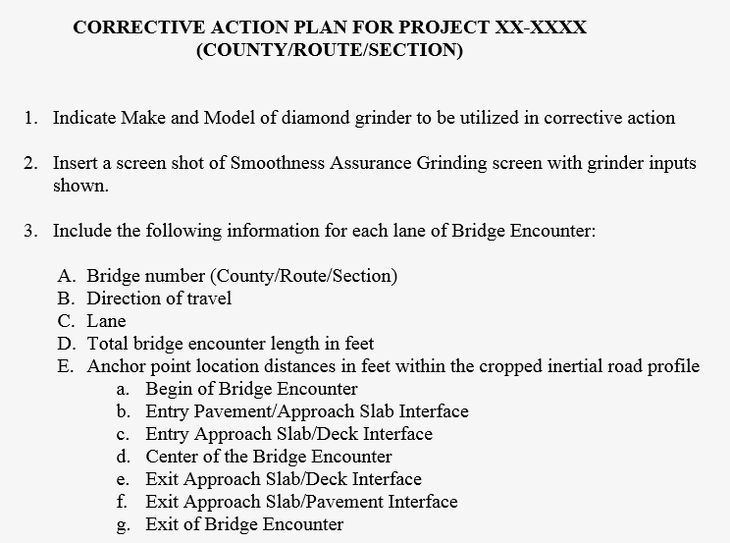
Proposal Note 555 Surface Smoothness for Bridges & Approaches Using International Roughness Index & ProVAL

Slide 26
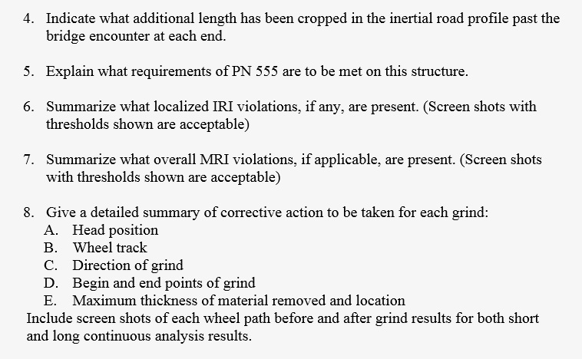
Proposal Note 555 Surface Smoothness for Bridges & Approaches Using International Roughness Index & ProVAL

Slide 27
Proposal Note 555 Surface Smoothness for Bridges & Approaches Diamond Grinding & Corrective Action Plans
Can’t grind through steel armor
Ensure sufficient reinforcing cover
Can’t go too deep on adjacent surface course
Ensure the Plan developed is what’s executed in the field!
Not following the plan = not meeting IRI criteria

Slide 28
Proposal Note 555 Surface Smoothness for Bridges & Approaches Diamond Grinding & Corrective Action Plans Asking a grinder operator to grind to a plan rather than use their experience, seat of the pants, naked eye. Operators are becoming increasingly comfortable with profiler technology and software predictions

Slide 29
Proposal Note 555 Surface Smoothness for Bridges & Approaches Diamond Grinding & Corrective Action Plans All grinders can fix many problems however some bridges may require a specific grinder Long features such as camber issues may require a long machine while short deep dips or slope breaks may require short machine

Slide 30
Proposal Note 555 Surface Smoothness for Bridges & Approaches Diamond Grinding & Corrective Action Plans Wherever possible, grind before deck grooving Phased projects require grooving if traffic is on bridge through winter We may explore other texturing alternatives in these cases 511.17 will not allow interim coarse broom finish on bridge deck work when opened to traffic over winter
Notes:
If the different stages or phases of the bridge deck work occur within one construction season, any stage opened to traffic shall receive an interim coarse broom finish during placement, then saw the longitudinal grooves after the final stage. The interim broom finish will not be allowed as a surface texture when opened to traffic over a winter season. Saw longitudinal grooves in the deck prior to opening to traffic for a winter season.

Slide 31
Proposal Note 555 Surface Smoothness for Bridges & Approaches Diamond Grinding & Corrective Action Plans Don’t correct the deck and approach slabs until surface pavement is in place High/low pavement or dips in entry exit pavement may cause you to grind into approach slab and possibly deck that didn’t have any spec violations on their own Bridge encounters built outside of the bounds of the general profile will not pass inertial profile PN 555 criteria

Slide 32
Proposal Note 555 Surface Smoothness for Bridges & Approaches Diamond Grinding & Corrective Action Plans Grinding won’t fix everything! High steel armor False work collapse Significant roughness or issues with entry or exit pavement

Slide 33
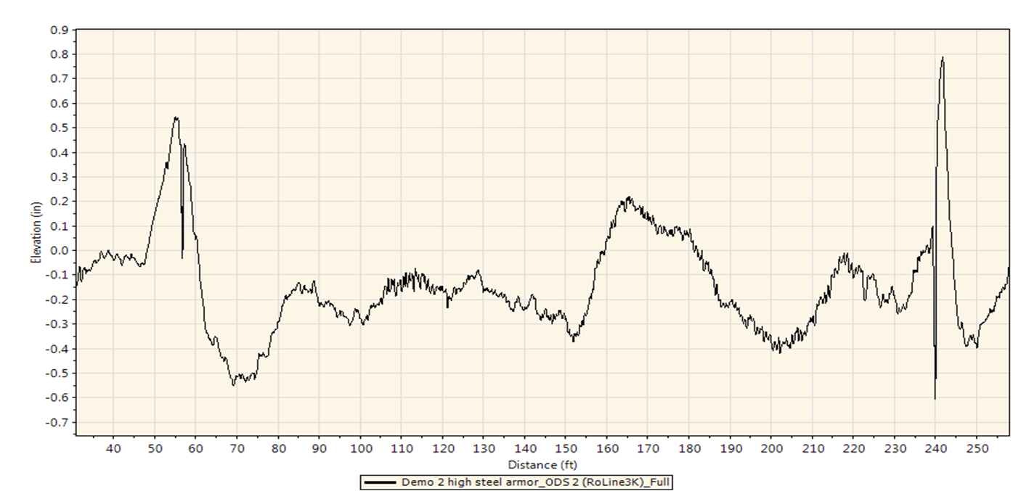
Proposal Note 555 Surface Smoothness for Bridges & Approaches High Steel Armor

Slide 34
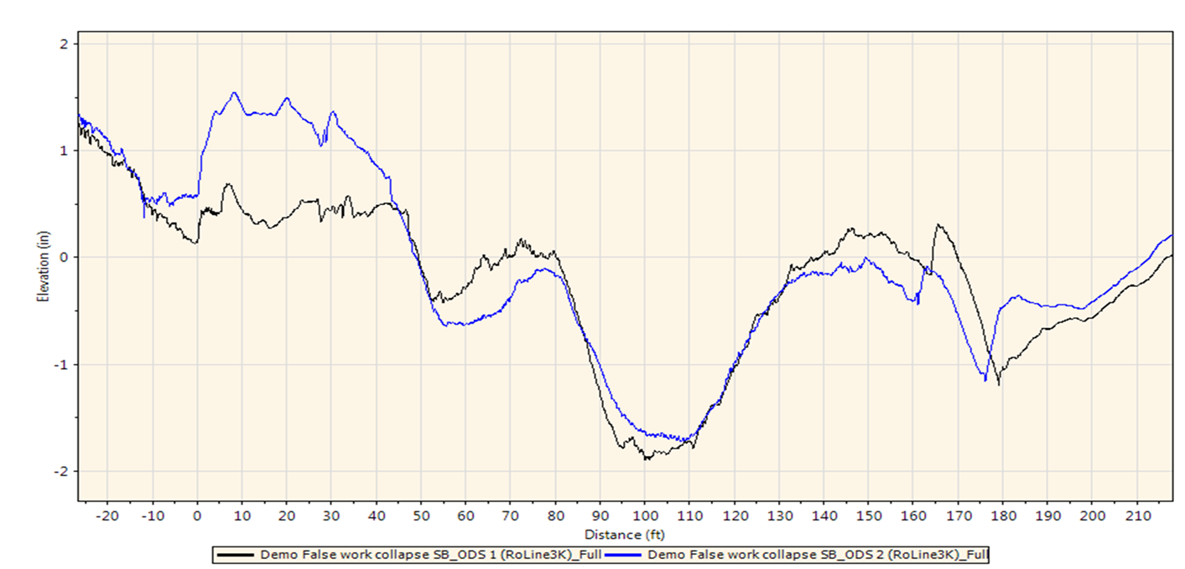
Proposal Note 555 Surface Smoothness for Bridges & Approaches False Work Issue

Slide 35
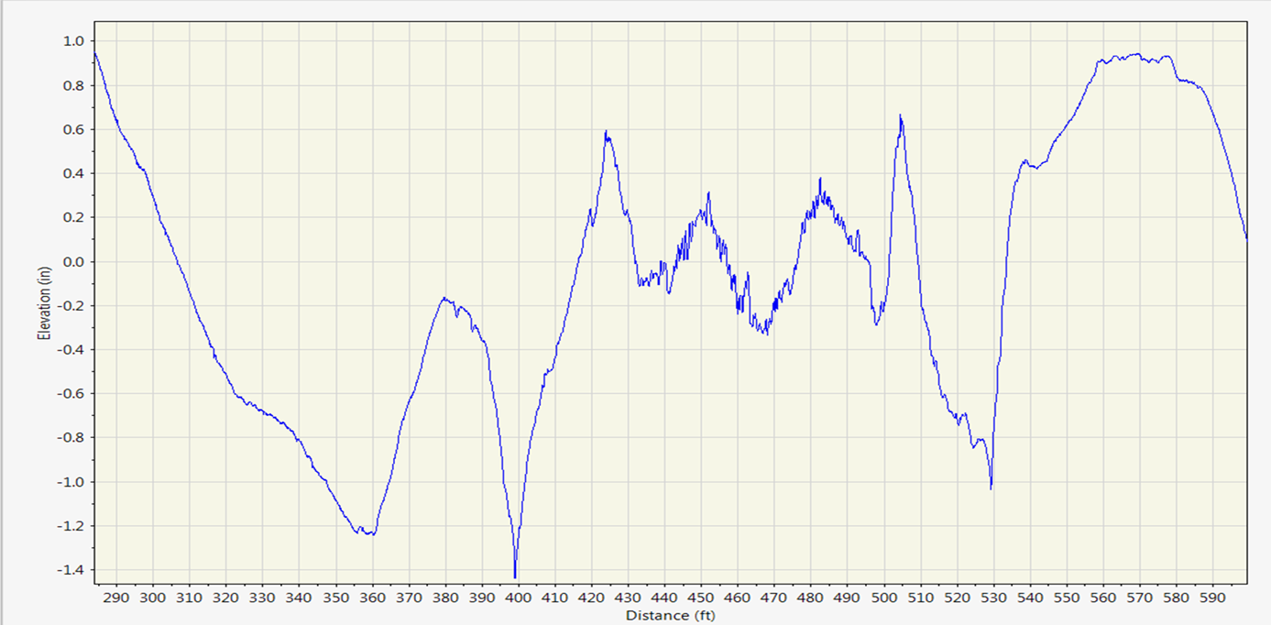
Proposal Note 555 Surface Smoothness for Bridges & Approaches Entry & Exit Pavement Anomalies

Slide 36
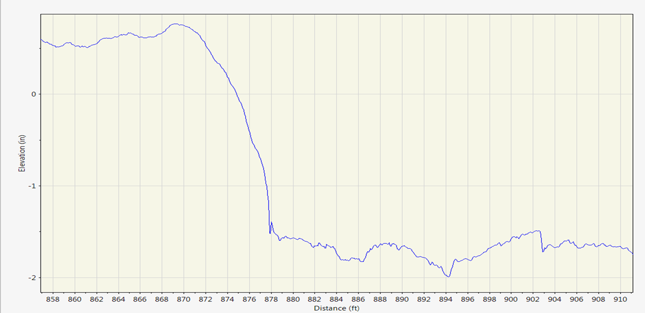
Proposal Note 555 Surface Smoothness for Bridges & Approaches Entry & Exit Pavement Anomalies

Slide 37
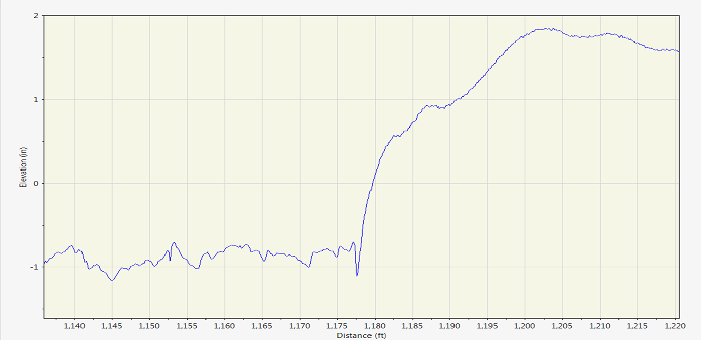
Proposal Note 555 Surface Smoothness for Bridges & Approaches Entry & Exit Pavement Anomalies

Slide 38
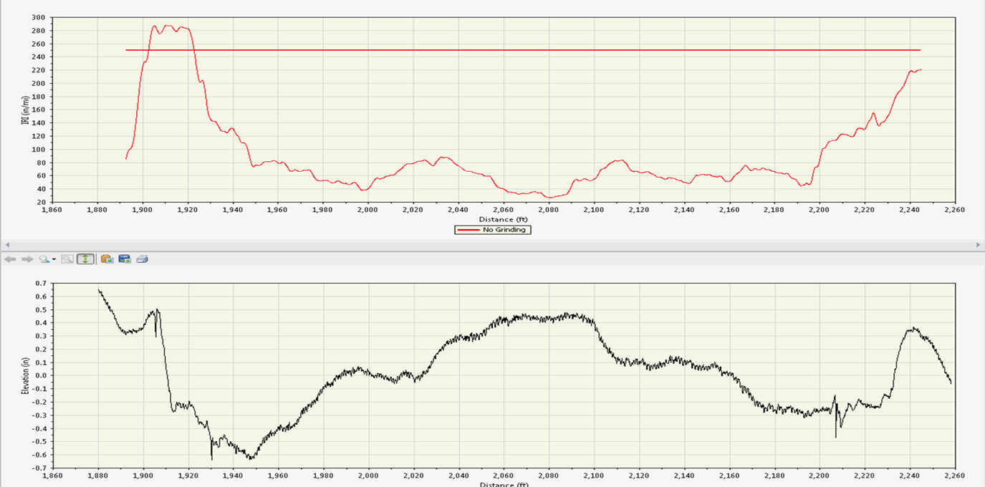
Proposal Note 555 Surface Smoothness for Bridges & Approaches Success –Localized Roughness LWP

Slide 39
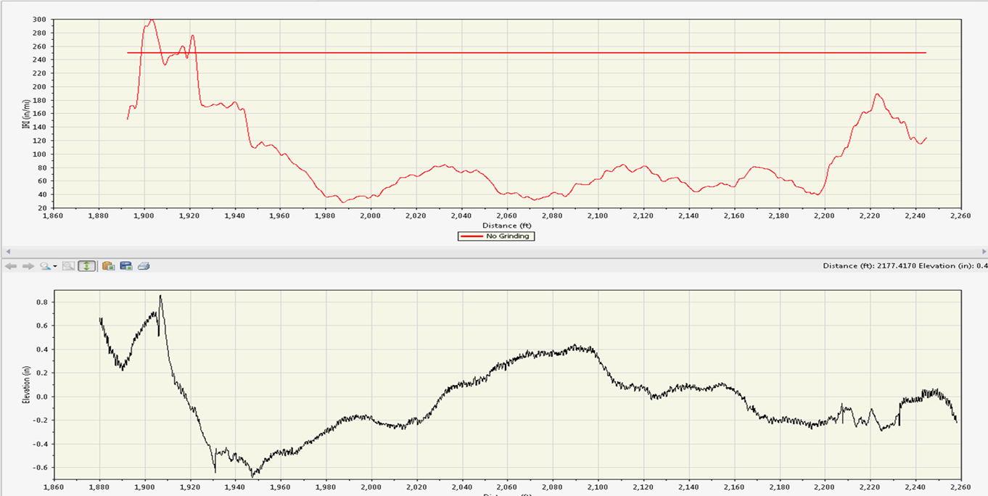
Proposal Note 555 Surface Smoothness for Bridges & Approaches Success –Localized Roughness RWP

Slide 40
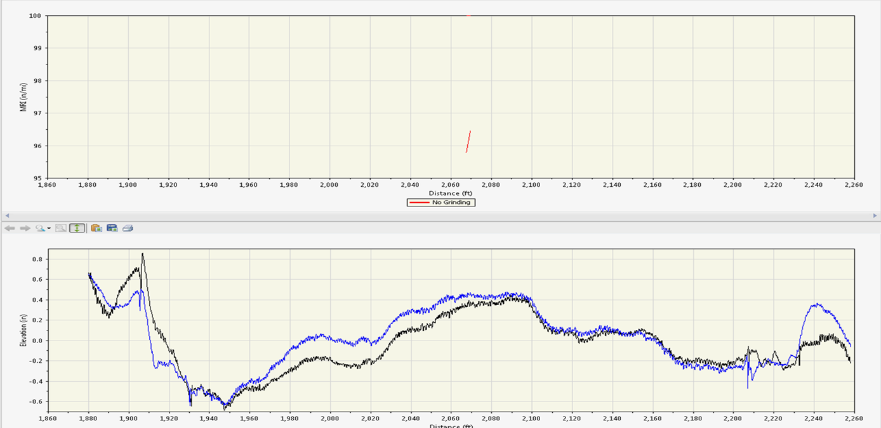
Proposal Note 555 Surface Smoothness for Bridges & Approaches Success –Overall Mean IRI (MRI)

Slide 41
Proposal Note 555 Surface Smoothness for Bridges & Approaches Future Considerations on Specification Changes Alternative texturing to deck grooving for bridges that are opened to traffic during winter period Issues with re-establishing grooves. Matching, etc.

Slide 42
Proposal Note 555 Surface Smoothness for Bridges & Approaches The Big Lessons Learned Develop enough Owner Agency experts/specialists up front (OH DOT IRI & ProVAL Specialist Users Group) Prepare for PN 555 up front and early Coordinate with Agency, Prime, and subs to construct all parts of the bridge encounter in a more seamless fashion ProVAL has proven to be a reliable tool at generating predictable outcomes which are replicated in the field

Slide 43
Proposal Note 555 Surface Smoothness for Bridges & Approaches The Big Lessons Learned Get your local grinding community comfortable with & understanding ProVAL, Grinding Simulations, and CAPs Follow the (approved) CAP in the field that was developed in the office Try to avoid building features that can’t reasonably be diamond ground

Slide 44
QUESTIONS?

